Slide 1


Conference in Doboj
First professional consultation: Transport of dangerous goods
Presentation
project DGTRANS
Transport of Dangerous Goods – Modernization of Curricula and Development of Trainings for Professionals in the Western Balkans HEIs (DGTRANS)
Call: Contract number 101082187-DGTRANS-ERASMUS-EDU-2022-CBH
Doboj, 05th -07th November 2024

Slide 2

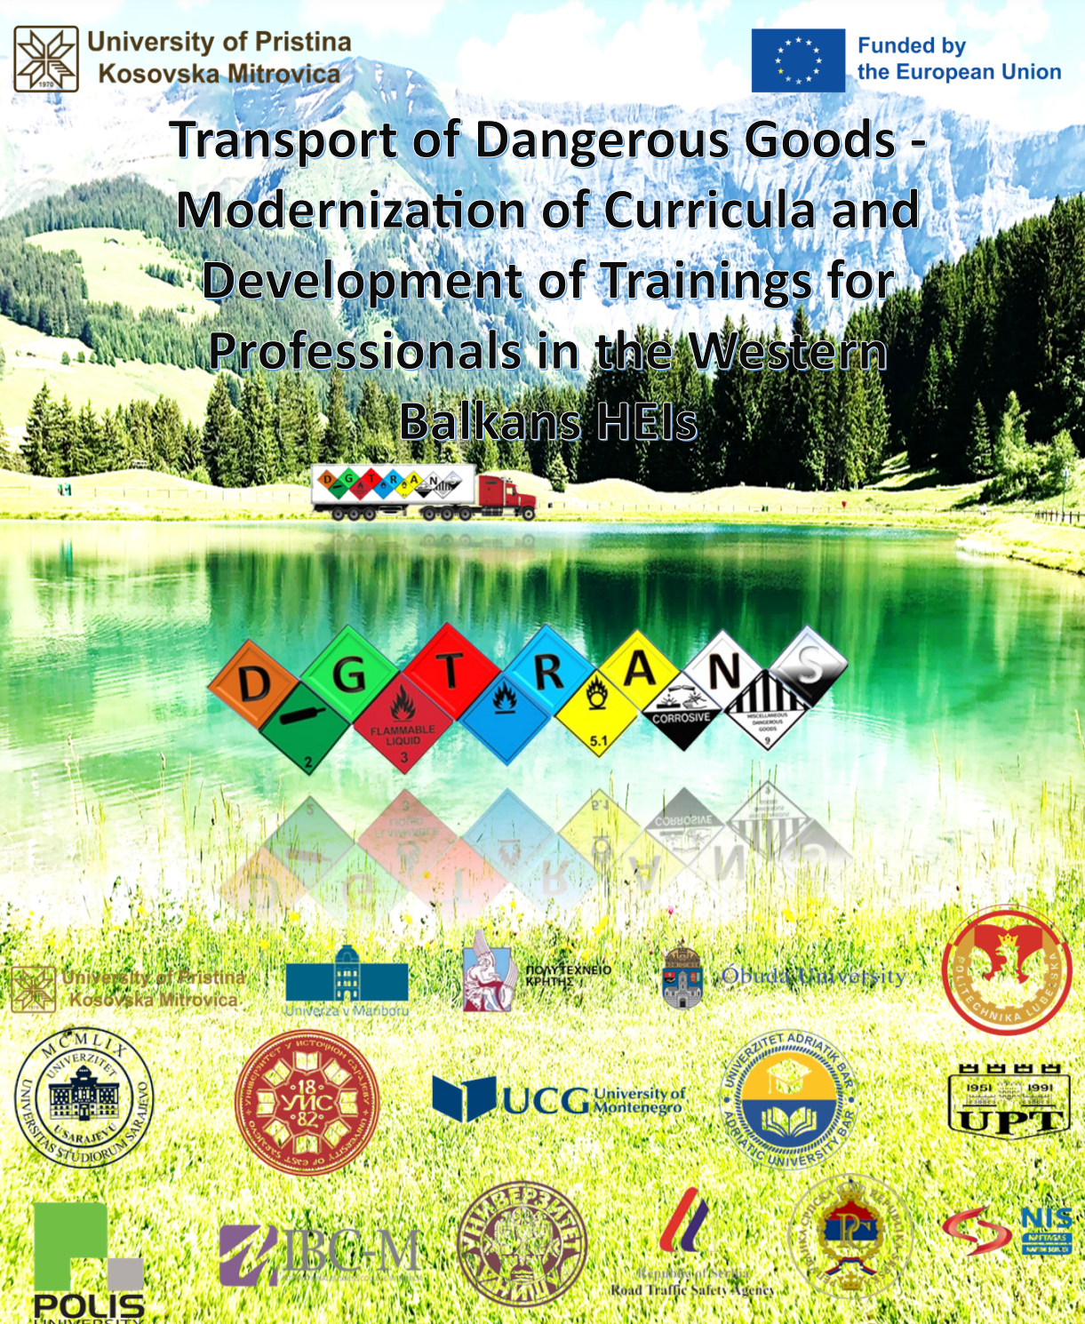
DGTRANS
TRANSport of Dangerous Goods – Modernization of Curricula and Development of Trainings for Professionals in the Western Balkans HEIs
Safety
Training
Dangerous Goods
Modernization
Development
WB HEIs Study Programs
https://dgtrans.pr.ac.rs/

Slide 3

OFFICIAL WEBSITE
https://dgtrans.pr.ac.rs/

Slide 4

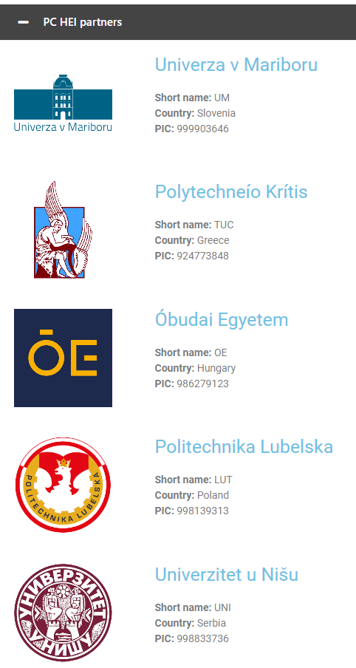

Consortium
Project consortium consists of
FOUR EU HEIs,
EIGHT WB HEIs,
THREE non-academic partner from WB countries (WBC) and
ONE associated partner (AP).
16 partners
Coordinator
EU HEI partners provide
- academic expertise,
- transfer innovative and newly developed technologies and
- know-how best practices
4 partners

Slide 5
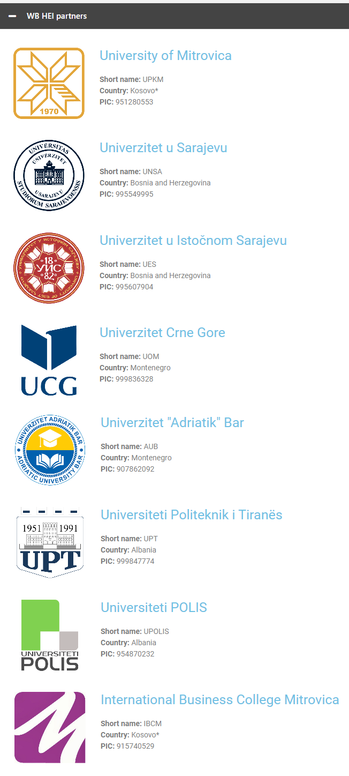


Consortium
Project consortium consists of
FOUR EU HEIs,
EIGHT WB HEIs,
THREE non-academic partner from WB countries (WBC) and
ONE associated partner (AP).
16 partners
workers
WB HEIs will improve the level of student competencies and skills through:
- modernization/development of Undergrad/Master studies curricula,
- increase the level of teaching staff expert and language skills,
- increase awareness of public sector on risks related to TDG and improve skills of TDG professionals through trainings devoted to them.

Slide 6

MAIN OBJECTIVES PROJECT
IMPROVE EXISTING AND DEVELOP NEW TDG CURRICULA for undergraduate and master studies in accordance with Bologna requirements and national accreditation standards through implementing new/modernized courses. These courses should cover provisions concerning dangerous goods, transport equipment and transport operations, as well as the risk assessment tools, vehicles monitoring systems, and route-planning systems based on network analyses performance. The aim of the improved study programs is to include the different disciplines such as transport, environmental sciences, politics, supply chain management, security management and the
ANALYSE AND IMPROVE CURRENT RISK ANALYSIS MANAGEMENT PROCEDURES AND RISK ASSESSMENTS on transport routes and new routing solutions into WBC. Herein, we are finding and applying the most appropriate scientific methods and the best practice about what issues should be included in risk analysis procedures to improve the safety during the TDG and how can management procedures be improved to avoid mistakes or inefficiencies during the sharing of information within a company and between different companies involved in the supply chain.
DEVELOP AND IMPLEMENT THE TRAINING PROGRAM FOR THE TDG PROFESSIONALS in line with ADR and up-to-date scientific knowledge on issues related to the TDG. According to ADR each TDG subject, involved in activities which include the consigning the TDG by road or the related packing, loading, filling or unloading, shall appoint one or more TDG professionals, responsible for prevention of the risks inherent in such activities with regard to persons, property and the environment.

Slide 7
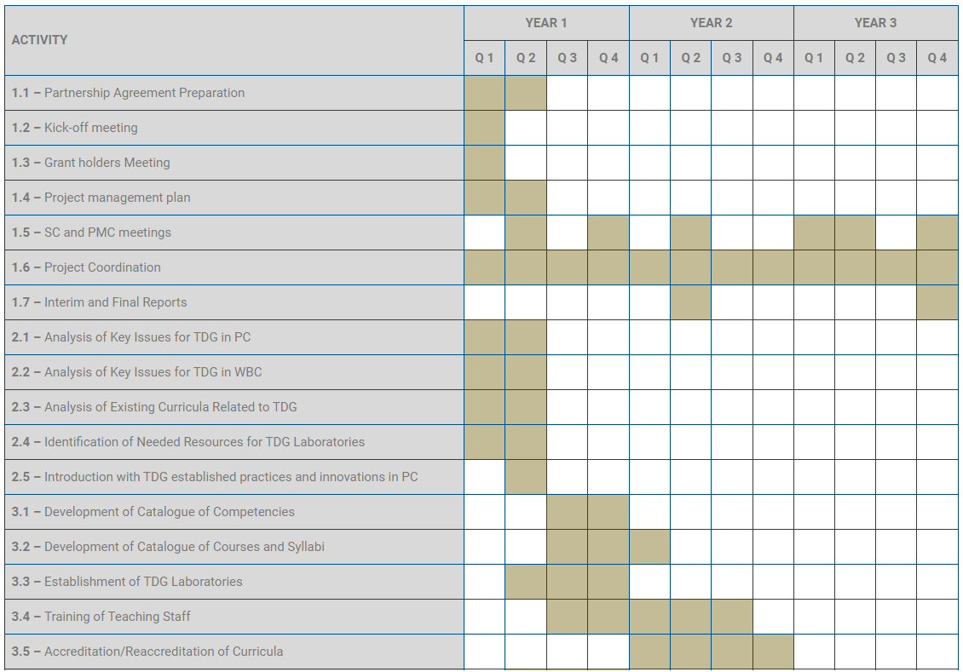
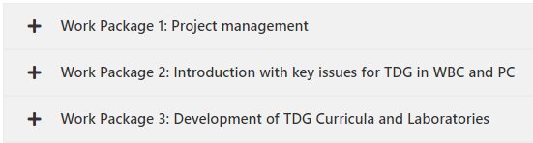

Workplan DGTRANS (3 Years)

Slide 8
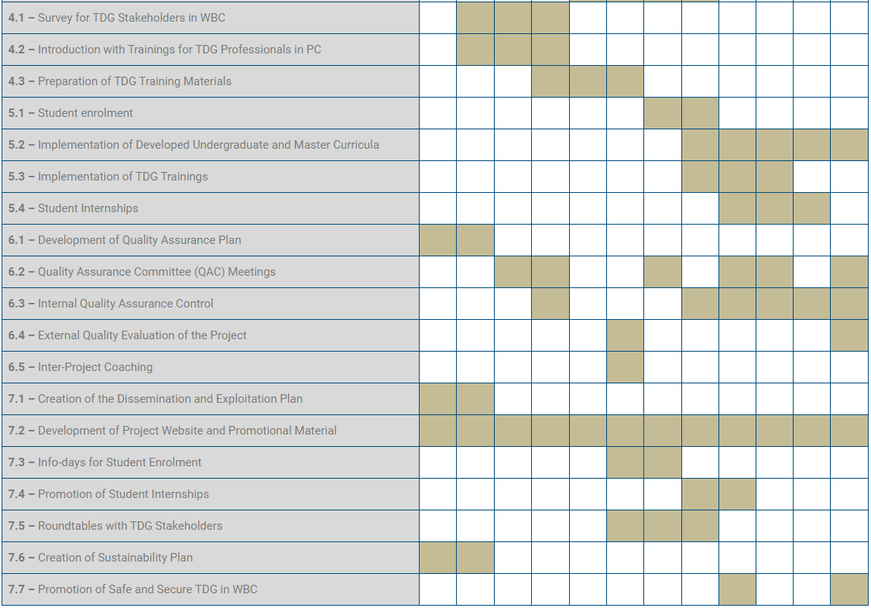
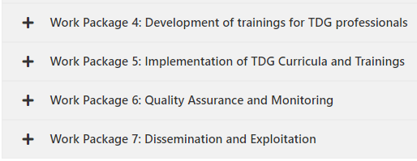
Workplan PELMOB (3 Years)

Slide 9












PROJECT ACHIEVEMENTS
11
11 REPORTS ON ANALYSES KEY ISSUES RELATED TO TDG
4 Reports per each WBC and 1 Integrate report
5 Reports per each PC and 1 Integrate report
Poland, Hungary, Slovnia, Greece
Bosnia and Herzegovina, Serbia, Kosovo*, Montenegro, Albania.
Report on analyses key issues related to TDG in Greece
Report on analyses key issues related to TDG in Bosnia and Herzegovina
Report on analyses key issues related to TDG in Slovenia
Report on analyses key issues related to TDG in Montenegro
Report on analyses key issues related to TDG in Hungary
Report on analyses key issues related to TDG in Kosovo*
Report on analyses key issues related to TDG in Poland
Report on analyses key issues related to TDG in Albania
Report on analyses key issues related to TDG in Serbia

Slide 10







PROJECT ACHIEVEMENTS
14
14 REPORTS ON ANALYSES EXISTING CURRICULA related to TDG in PC and WB HEIs
8 WB HEIs and 5 PC Reports on Analysis on existing curricula related to TDG and 1 Integrate report
Polytechneío Krítis
Report on analyses Existing Curricula related to TDG in TUC
University of Mitrovica
Univerzitet "Adriatik" Bar
Report on analyses Existing Curricula related to TDG in UPKM
Report on analyses Existing Curricula related to TDG in AUB
Univerza v Mariboru
Report on analyses Existing Curricula related to TDG in UM
Univerzitet u Sarajevu
Universiteti Politeknik i Tiranës
Report on analyses Existing Curricula related to TDG in UNSA
Report on analyses Existing Curricula related to TDG in UPT
Óbudai Egyetem
Report on analyses Existing Curricula related to TDG in OE
Univerzitet u Istočnom Sarajevu
Universiteti POLIS
Report on analyses Existing Curricula related to TDG in UES
Report on analyses Existing Curricula related to TDG in UPOLIS
Politechnika Lubelska
Report on analyses Existing Curricula related to TDG in LUT
Univerzitet Crne Gore
International Business College Mitrovica
Report on analyses Existing Curricula related to TDG in UOM
Report on analyses Existing Curricula related to TDG in IBCM
Univerzitet u Nišu
Report on analyses Existing Curricula related to TDG in UNI

Slide 11

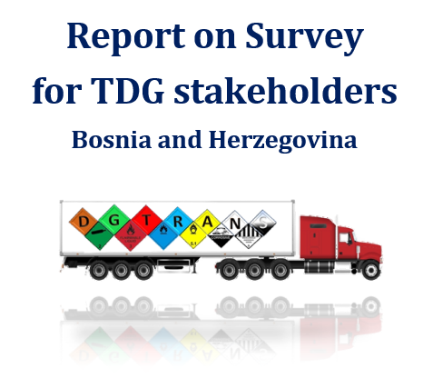


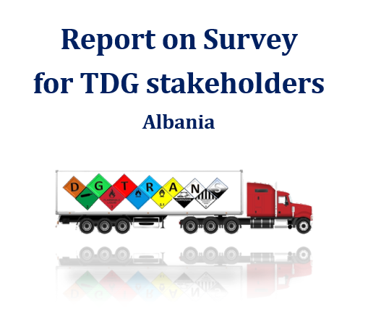
PROJECT ACHIEVEMENTS
4
4 REPORT ON SURVEY FOR TDG STAKEHOLDERS
Bosnia and Herzegovina, Kosovo*, Montenegro, Albania

Slide 12

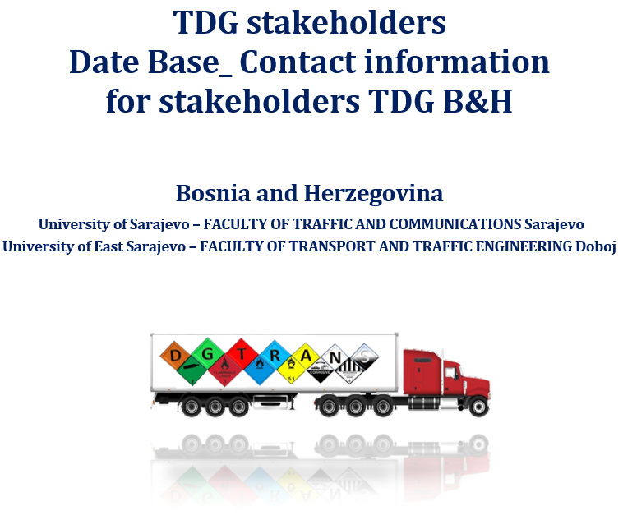
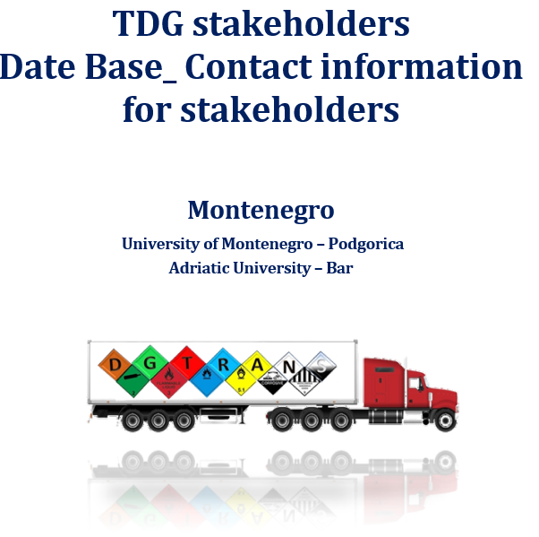

PROJECT ACHIEVEMENTS
4
4 DATE BASE_ CONTACT INFORMATION FOR STAKEHOLDERS
Bosnia and Herzegovina, Kosovo*, Montenegro, Albania

Slide 13




PROJECT ACHIEVEMENTS
4
4 LOCAL WORKSHOP WITH STAKEHOLDERS
Bosnia and Herzegovina, Kosovo*, Montenegro, Albania

Slide 14
PROJECT ACHIEVEMENTS
8
8 CATALOGUE OF COMPETENCES
developed and implemented TDG curricula
2 in Bosnia and Herzegovina, 2 in Kosovo*, 2 in Montenegro, 2 in Albania.
CATALOGUE OF COMPETENCIES UPKM
CATALOGUE OF COMPETENCIES AUB
CATALOGUE OF COMPETENCIES UNSA
CATALOGUE OF COMPETENCIES UPT
CATALOGUE OF COMPETENCIES UES
CATALOGUE OF COMPETENCIES UPOLIS
CATALOGUE OF COMPETENCIES UOM
CATALOGUE OF COMPETENCIES IBCM

Slide 15
PROJECT ACHIEVEMENTS
8
8 CATALOGUE OF COURSES
developed and implemented TDG curricula
2 in Bosnia and Herzegovina, 2 in Kosovo*, 2 in Montenegro, 2 in Albania.
CATALOGUE OF COURSES
UPKM
CATALOGUE OF COURSES
AUB
CATALOGUE OF COURSES
UNSA
CATALOGUE OF COURSES
UPT
CATALOGUE OF COURSES
UES
CATALOGUE OF COURSES UPOLIS
CATALOGUE OF COURSES
UOM
CATALOGUE OF COURSES
IBCM

Slide 16

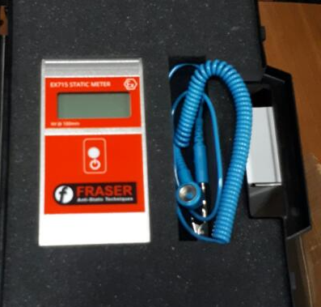
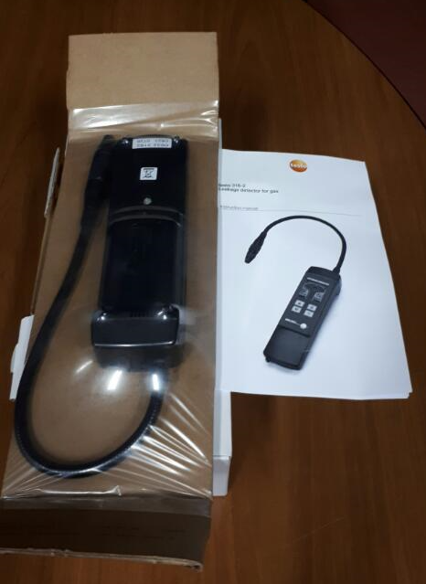
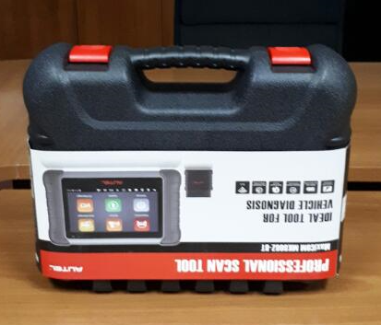


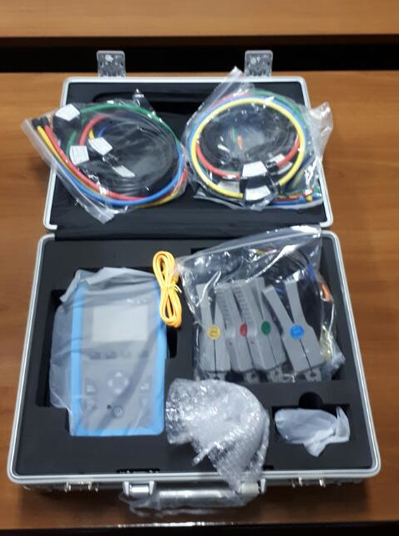
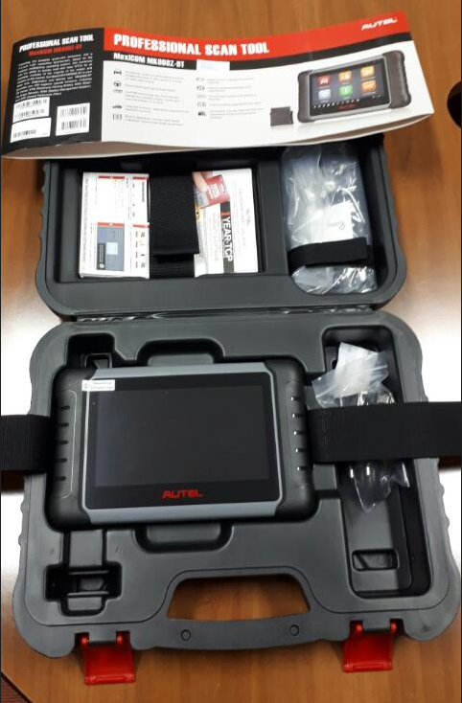
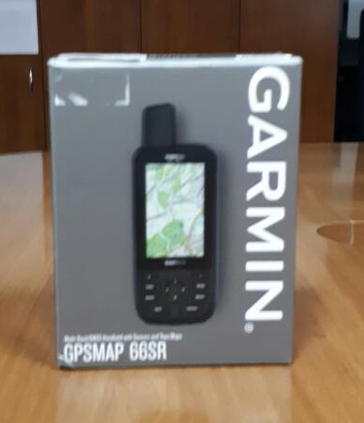
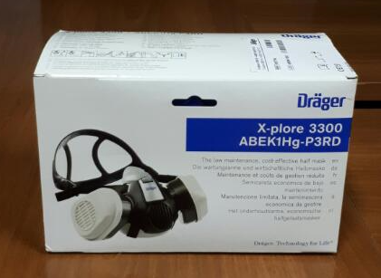
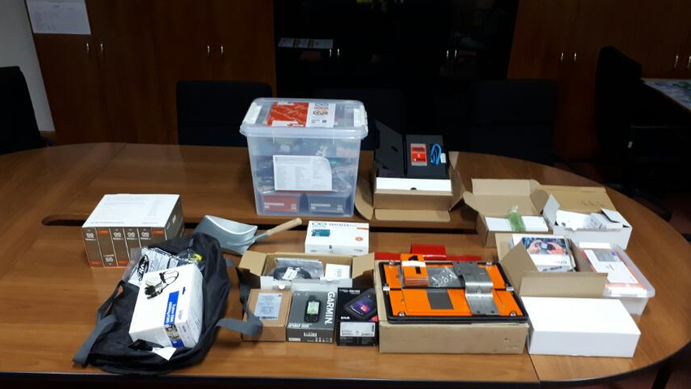
PROJECT ACHIEVEMENTS
8
8 NEW LABORATORIES
established with appropriate equipment and manuals.
2 in Bosnia and Herzegovina, 2 in Kosovo*, 2 in Montenegro, 2 in Albania.
ESTABLISHED LABORATORY
UPKM
ESTABLISHED LABORATORY
AUB
ESTABLISHED LABORATORY
UNSA
ESTABLISHED LABORATORY
UPT
ESTABLISHED LABORATORY
UES
ESTABLISHED LABORATORY
UPOLIS
ESTABLISHED LABORATORY
UOM
ESTABLISHED LABORATORY
IBCM

Slide 17
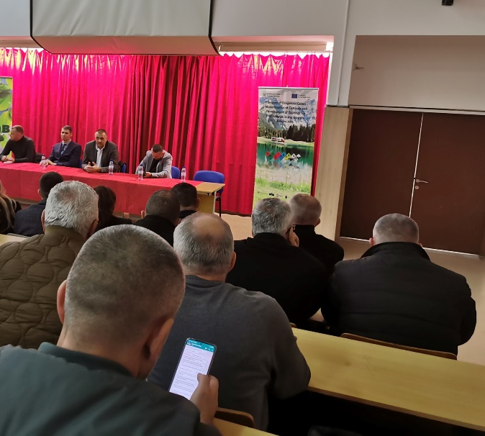
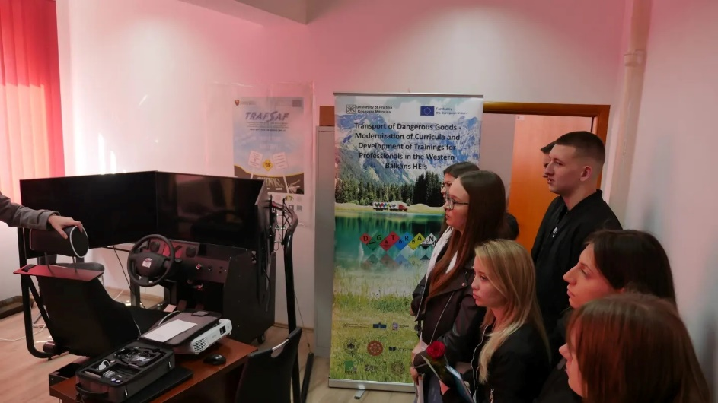
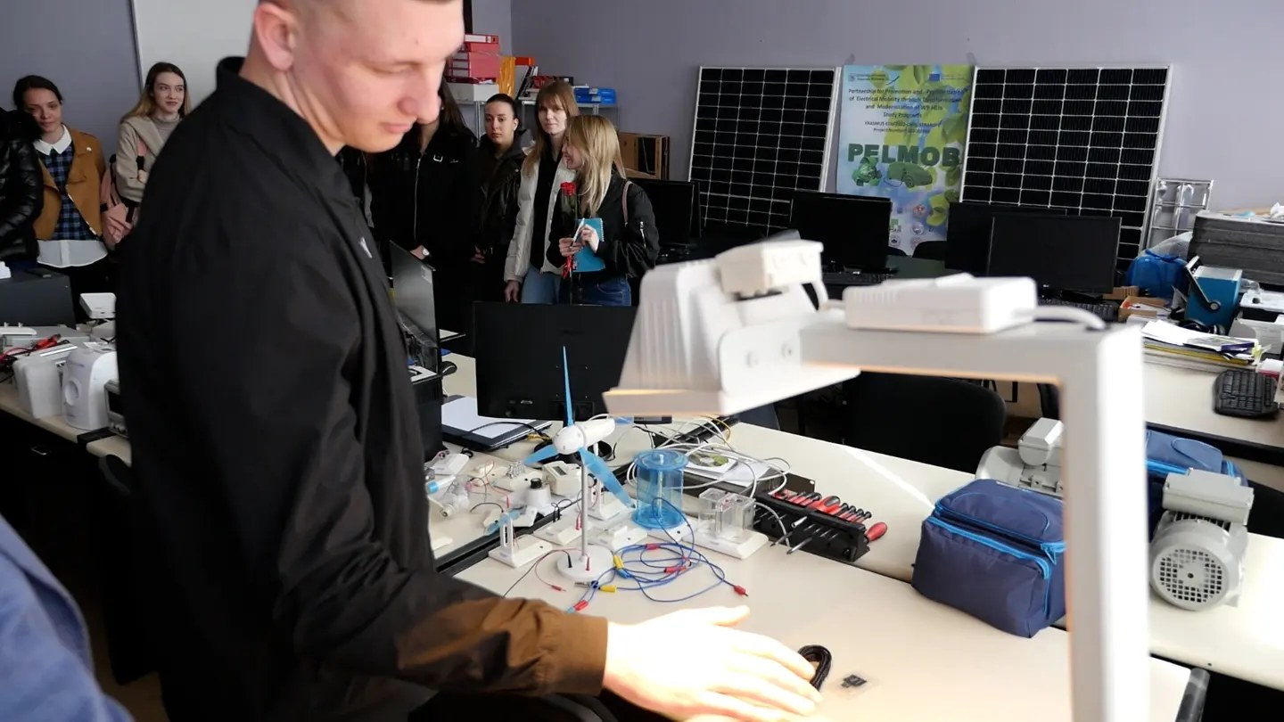
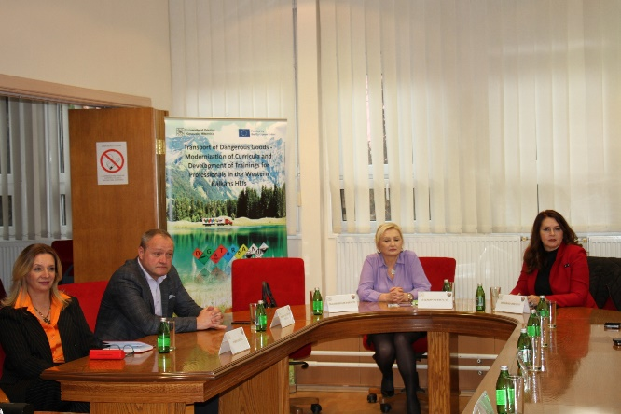
PROJECT ACHIEVEMENTS
8
8 NEW LABORATORIES
established with appropriate equipment and manuals.
2 in Bosnia and Herzegovina, 2 in Kosovo*, 2 in Montenegro, 2 in Albania.
ESTABLISHED LABORATORY UPKM

Slide 18
PROJECT ACHIEVEMENTS
8
8 NEW LABORATORIES
established with appropriate equipment and manuals.
2 in Bosnia and Herzegovina, 2 in Kosovo*, 2 in Montenegro, 2 in Albania.
ESTABLISHED LABORATORY UNSA

Slide 19

PROJECT ACHIEVEMENTS
8
8 BROCHURE FOR TRAINING PROFESSIONALS OF TDG

Slide 20
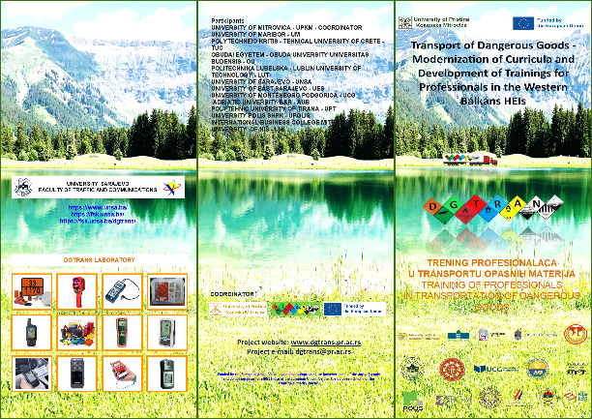
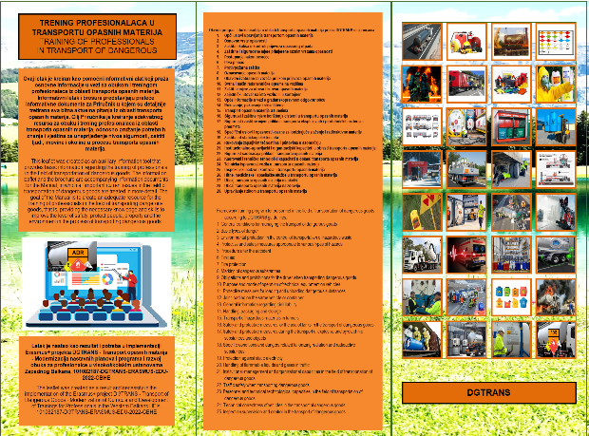
PROJECT ACHIEVEMENTS
8
8 LAFLET FOR TRAINING PROFESSIONALS OF TDG

Slide 21
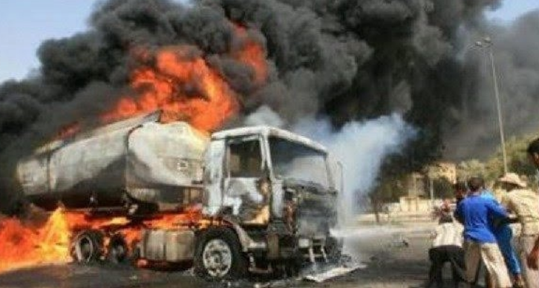
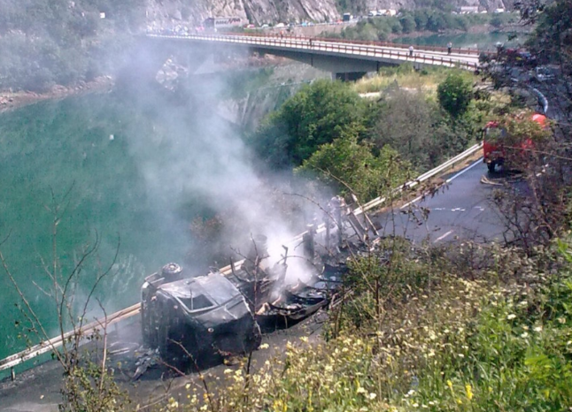
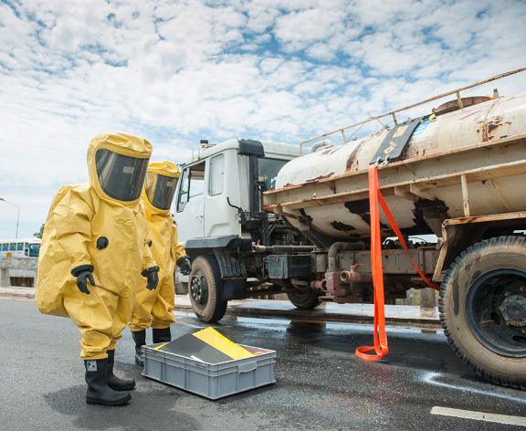
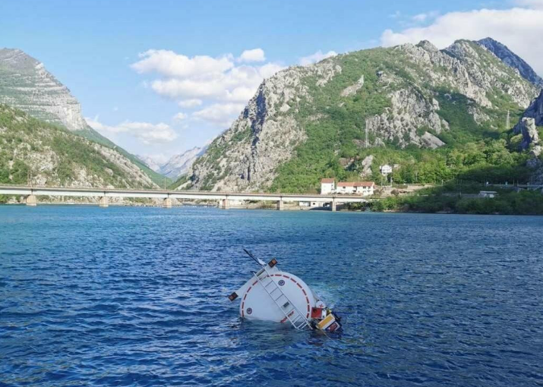
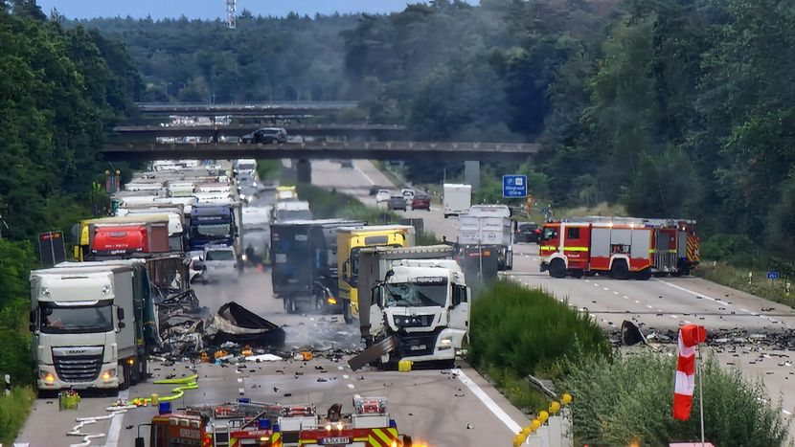
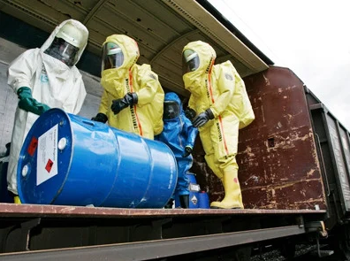
GLOBAL EFFECTS OF PROJECT
TRAFFIC SAFETY
ENVIRONMENTAL PROTECTION
HEALTH PROTECTION
TRAFFIC SAFETY
ENVIRONMENTAL PROTECTION
HEALTH PROTECTION

Slide 22

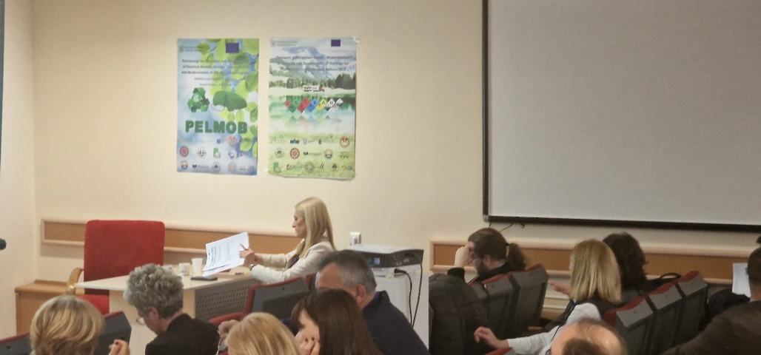
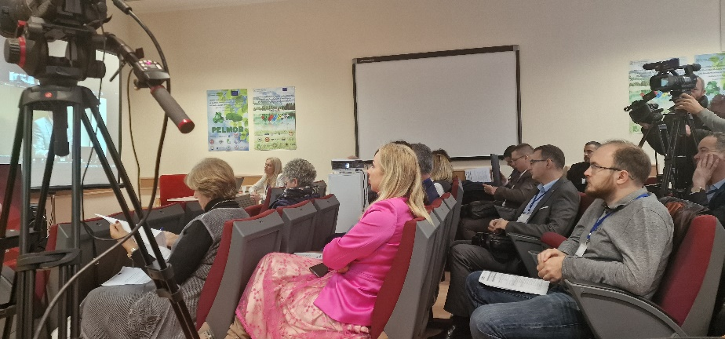
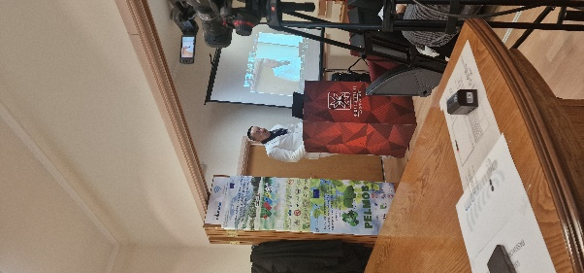
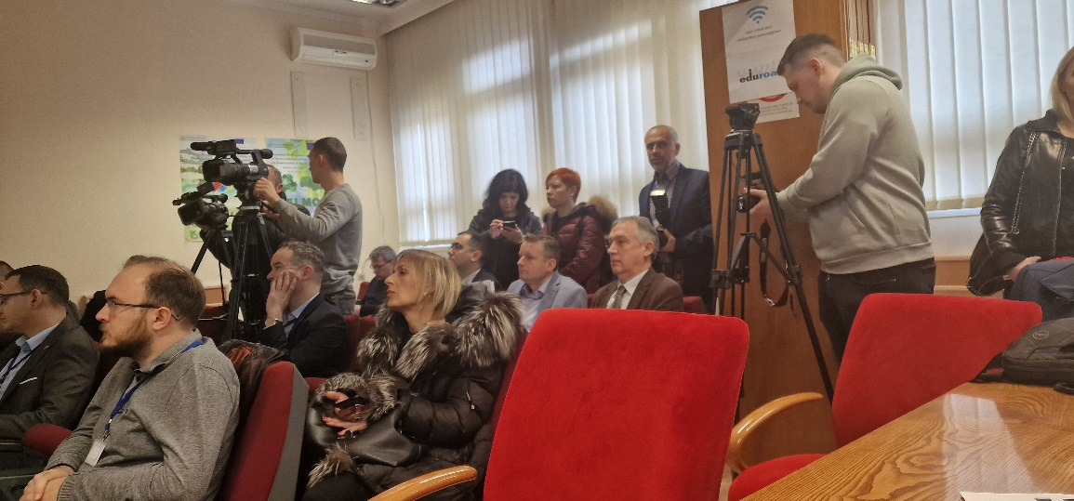
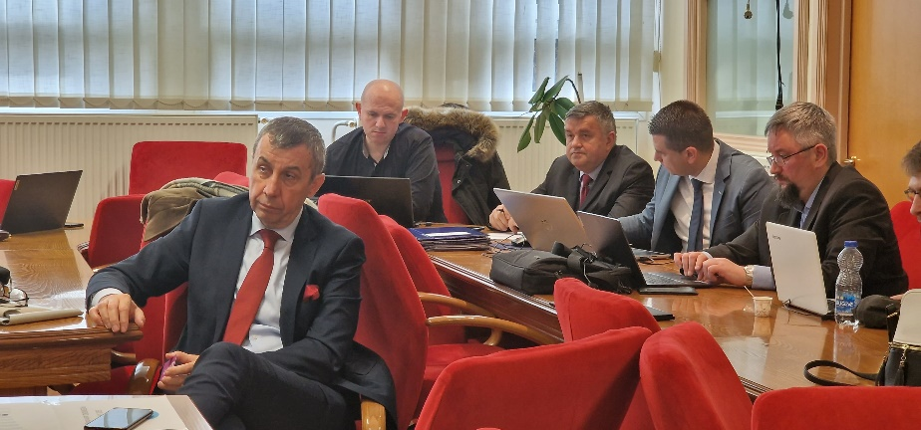
Educational SOCIAL
EFFECTS
Kick-off Meeting
1-2 March 2023 at the
University of Mitrovica

Slide 23

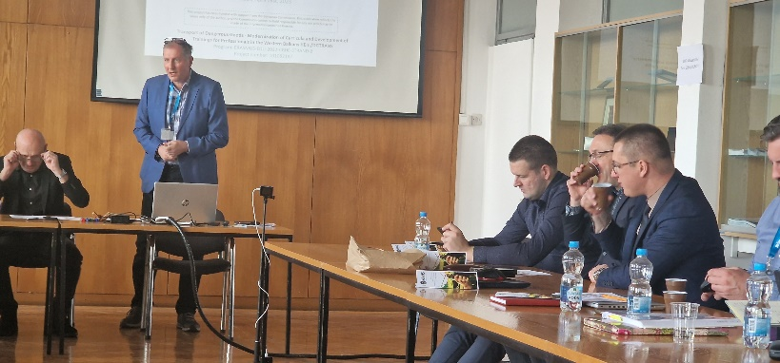
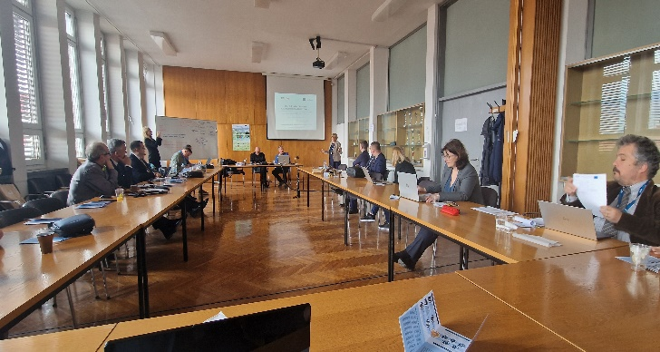
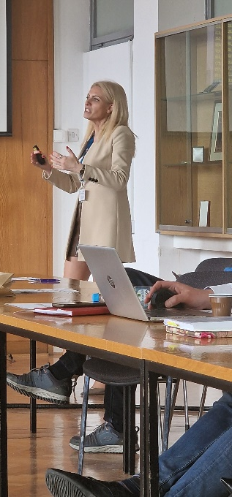
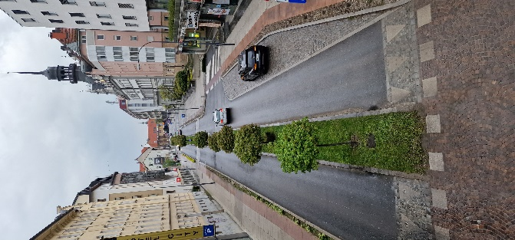
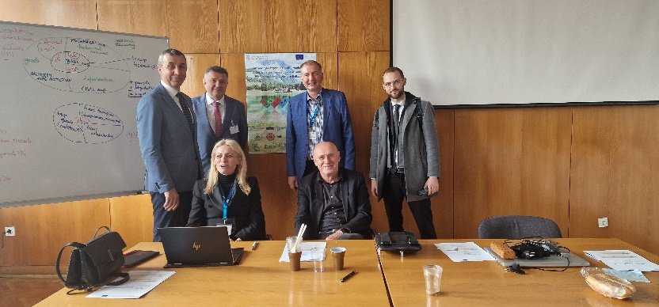
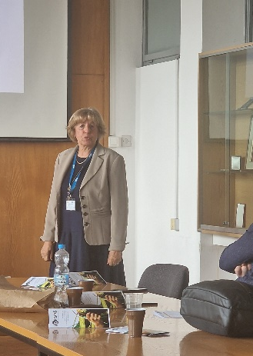
Educational SOCIAL
EFFECTS
Workshop in
University of Maribor
17-21 April 2023

Slide 24

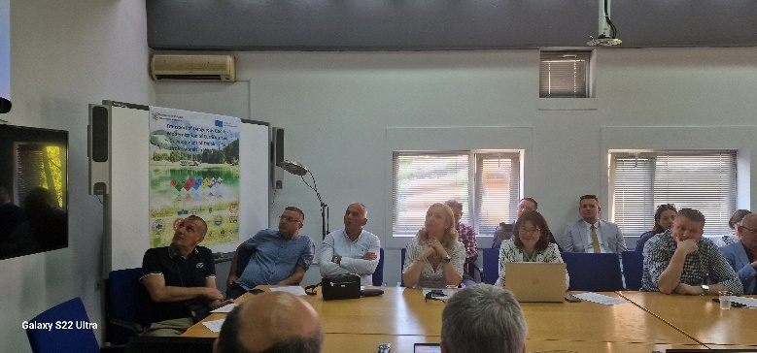
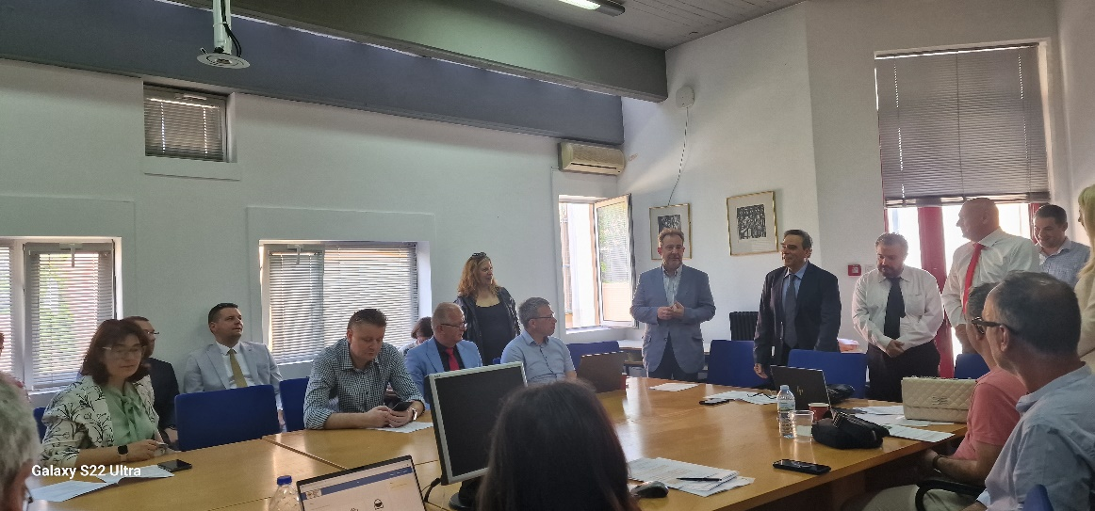
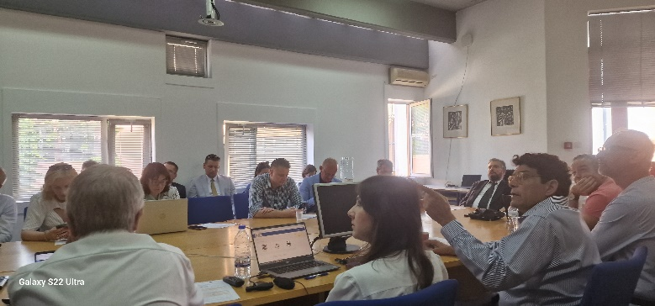
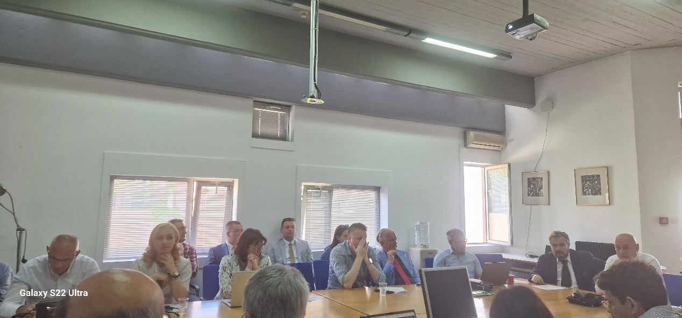
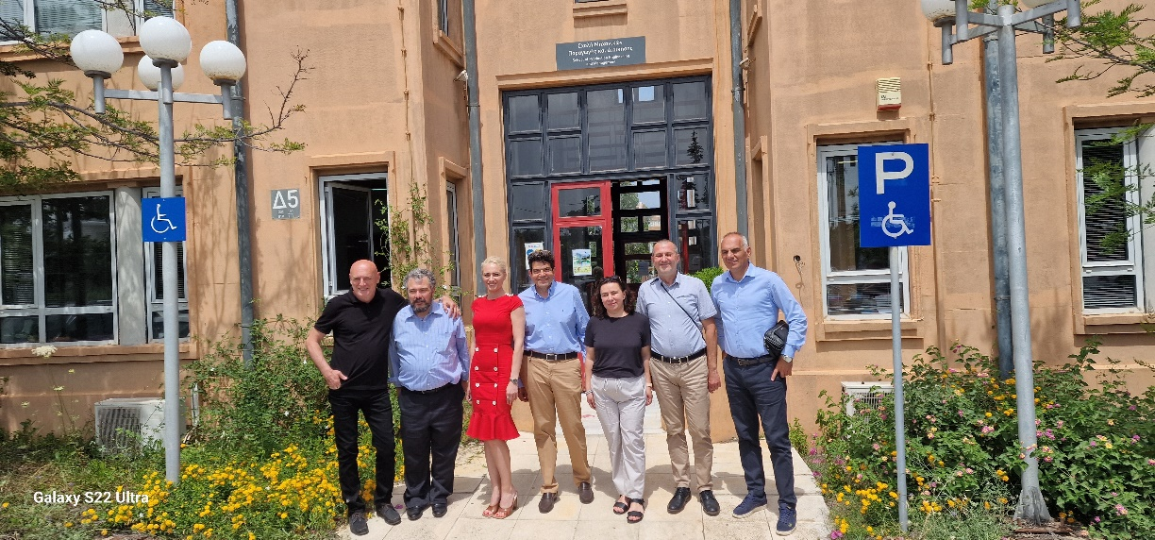
Educational SOCIAL
EFFECTS
Training for teaching staff at
Technical University of Crete, Greece
6th -8th June 2023

Slide 25

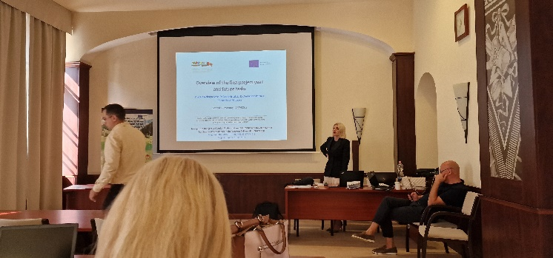
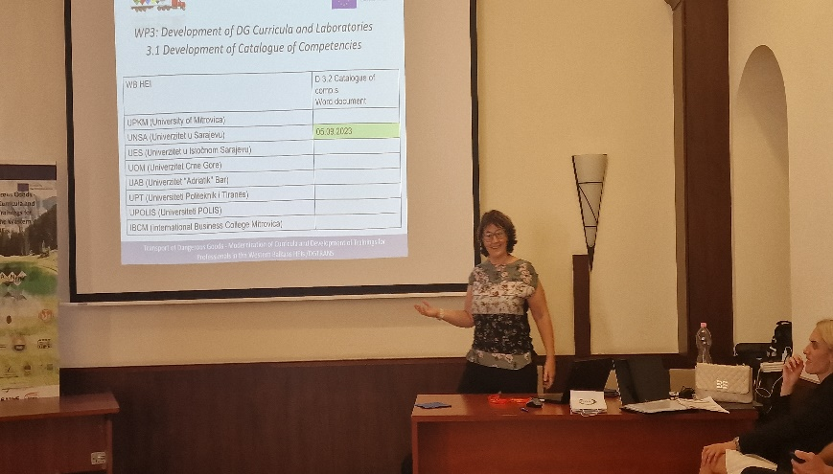
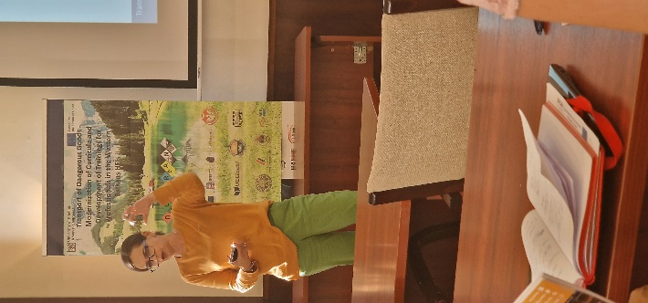



Educational SOCIAL
EFFECTS
Training for teaching staff ,
Óbuda University, Hungary
26th -28th September 2023

Slide 26







Educational SOCIAL
EFFECTS
Training teaching staff in TDG at
Lublin University of Technology, Poland
14th -16th November 2023

Slide 27







Educational SOCIAL
EFFECTS
Training eaching staff in TDG
University of Nis, Serbia,
20th-22ndFebruary 2024

Slide 28






Educational SOCIAL
EFFECTS
Training eaching staff in TDG
University of Montenegro,
23th-25nd April 2024

Slide 29










Educational SOCIAL
EFFECTS
TRAINING FOR PROFESSIONALS IN DG
at Adriatic University Bar, Faculty for traffic, communication and logistic Budva, Montenegro
10th -14th June 2024

Slide 30



SOCIAL NETWORK
https://www.facebook.com/people/Dgtrans-Erasmus/100090385493670/
https://www.linkedin.com/company/dgtrans-erasmus/

Slide 31




Thank you
for your attention

